Slide 2
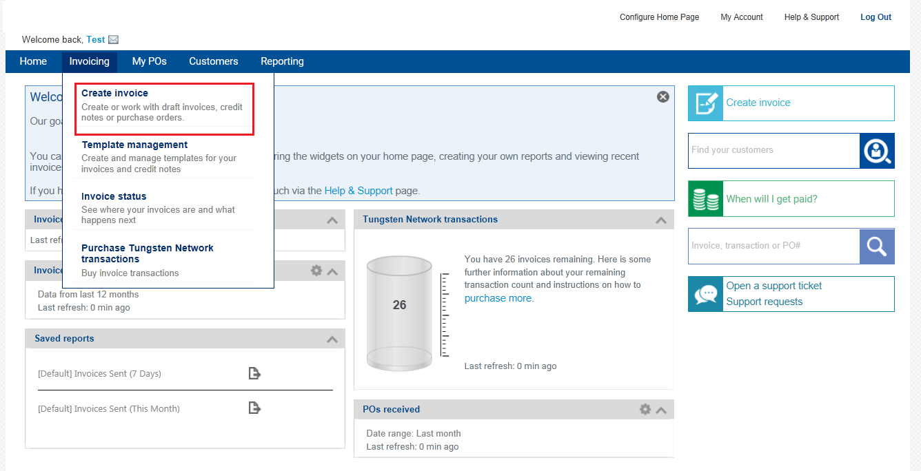
Submitting an invoice with the Tungsten Portal
Select ‘Create invoice’ from the ‘Invoicing’ drop-down menu

Slide 3
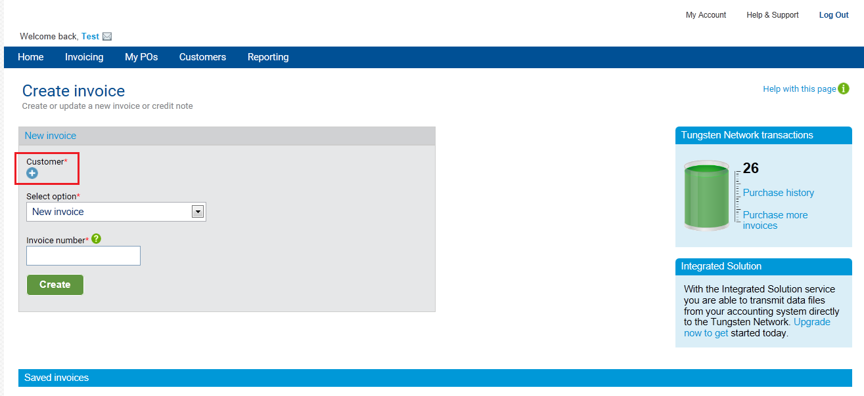
Select the Caterpillar company
Click on the ‘Customer’ icon to choose which Caterpillar company you will be invoicing

Slide 4
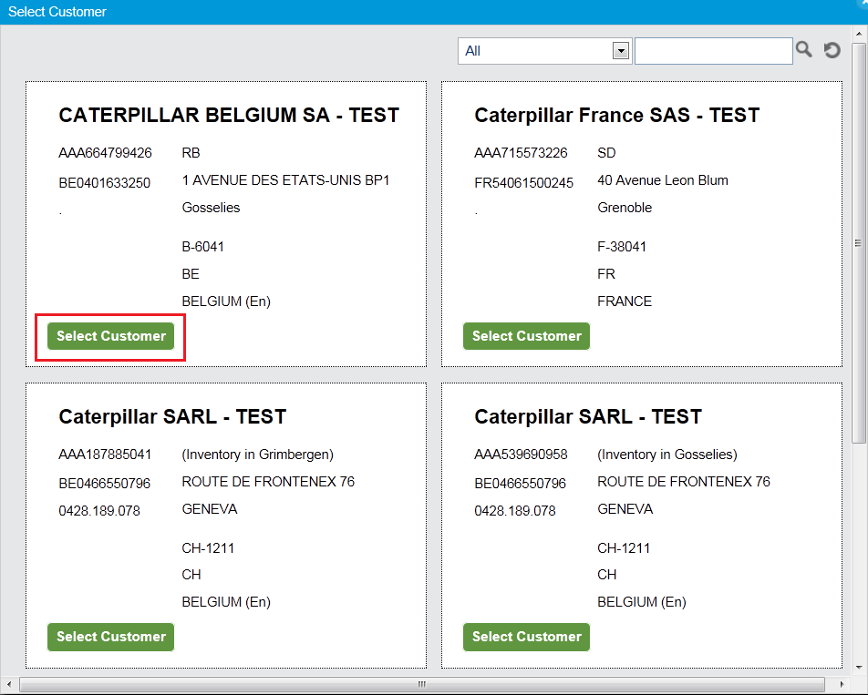
Select the Caterpillar company
Click on the ‘’Select customer’ icon to choose from the available list displayed

Slide 5
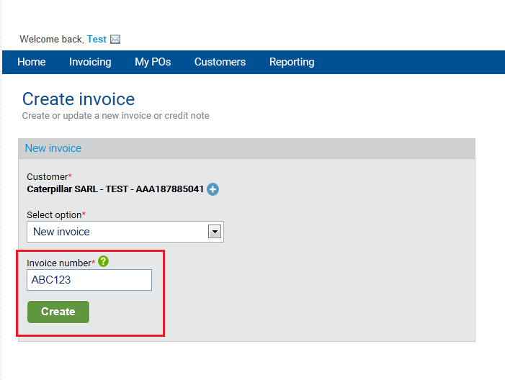
Enter your invoice number
In the ‘Invoice number’ box input your invoice reference number. Then click on ‘Create’ to generate the invoice

Slide 6
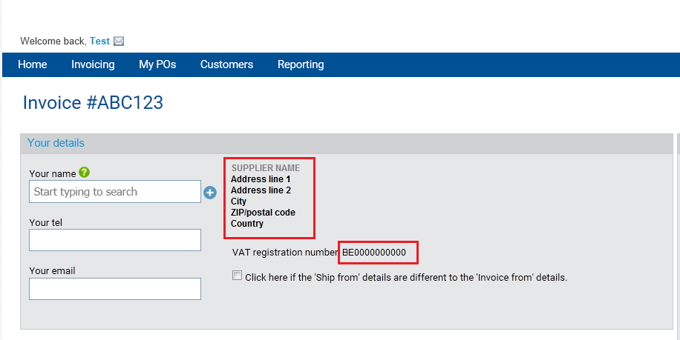
Check your company details
Ensure your company name, address and VAT number is correct

Slide 7
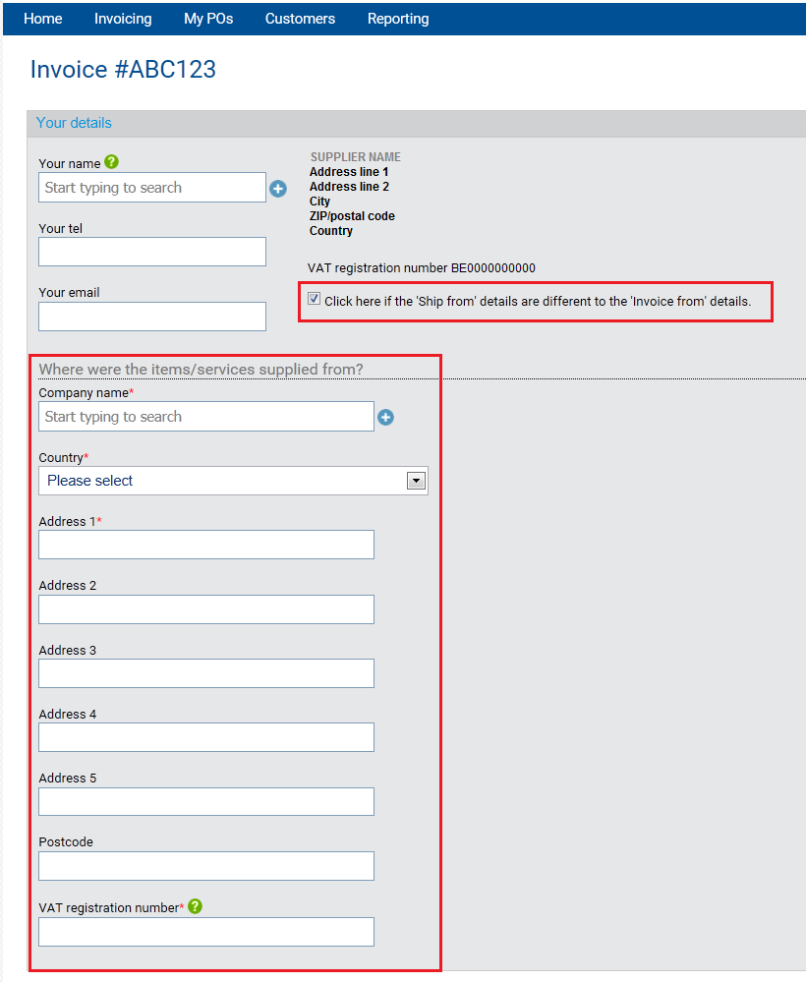
Change the ‘ship from’ address for the invoice
Click on the box beside ‘Click here if ship from details are different..’
A new section to enter the ‘ship from’ address is revealed.

Slide 8
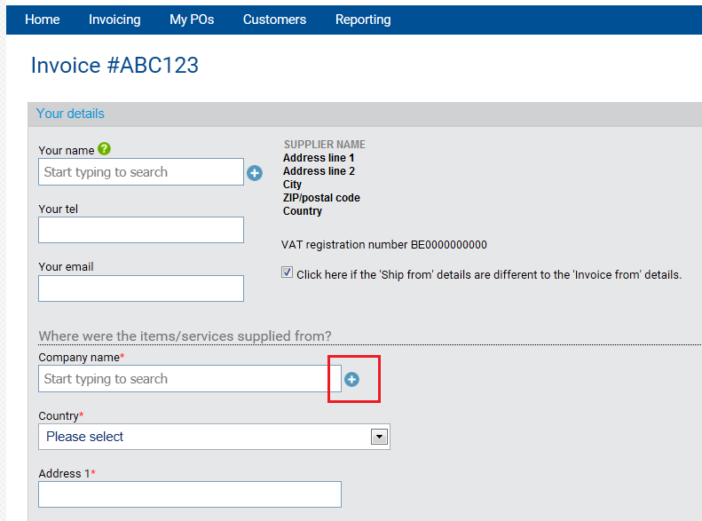
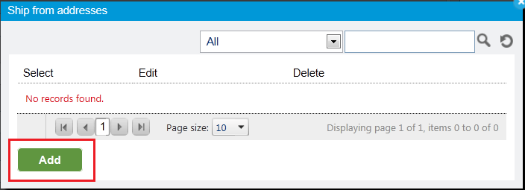
Save ‘ship from’ addresses for future invoices
Click on the icon to the right hand side of the ‘Company name’ box
A ‘Ship from addresses’ window will appear. Click on the Add button

Slide 9
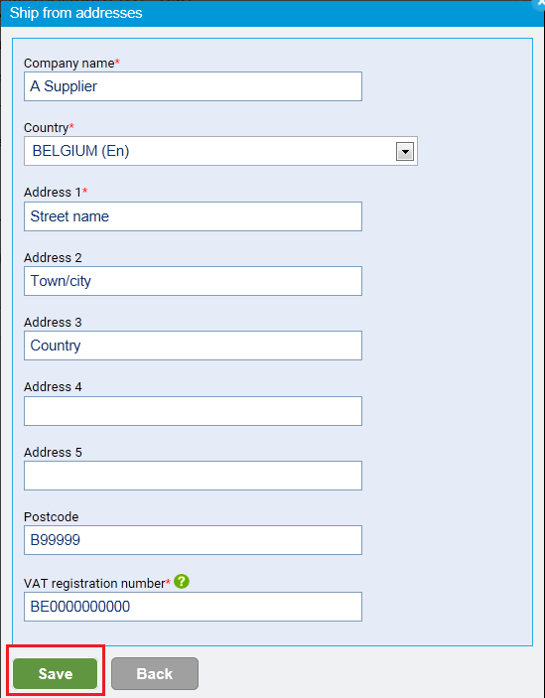
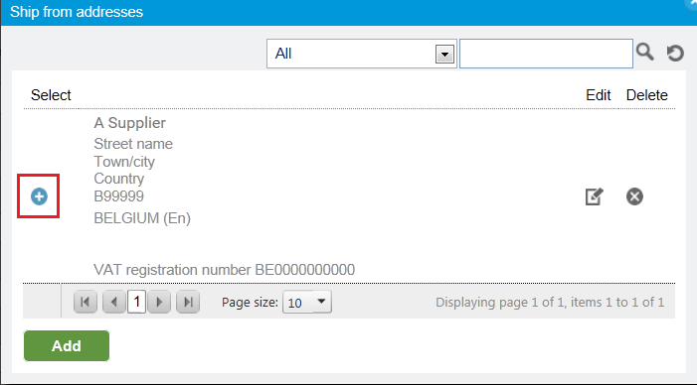
Save ‘ship from’ addresses for future invoices
Enter the required information into each box and click on the Save button. This address is now saved for future invoices.
Click on the blue icon under ‘select’ to choose from the list of saved addresses

Slide 10
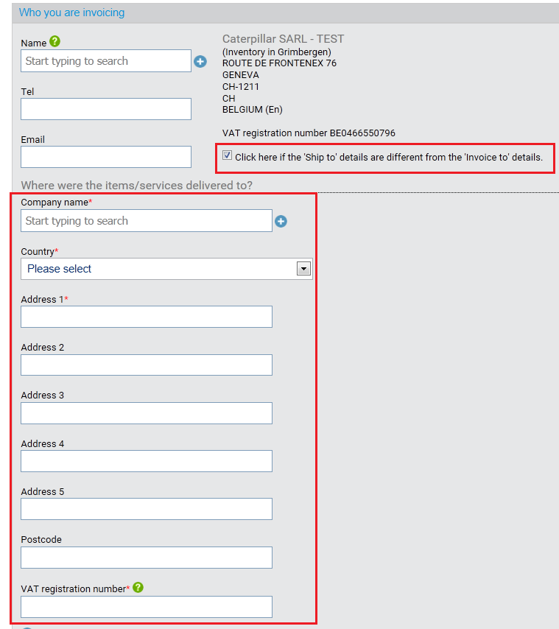
Change the ‘ship to’ address for the invoice (required)
In the ‘Who you are invoicing’ section click on the box beside ‘Click here if ship to details are different..’
A new section to enter the ‘ship to’ address is revealed.
The ship to address will be incorrect if you do not provide it for each invoice

Slide 11
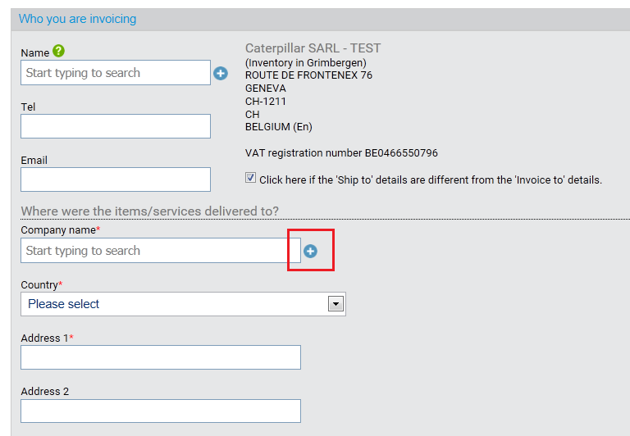
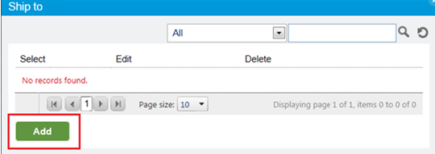
Change the ‘ship to’ address for the invoice (required)
Click on the icon to the right hand side of the ‘Company name’ box
A ‘Ship from addresses’ window will appear. Click on the Add button

Slide 12
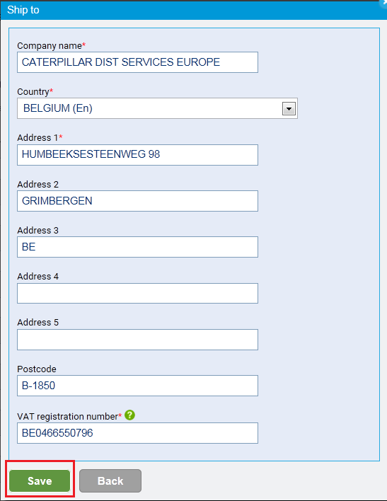
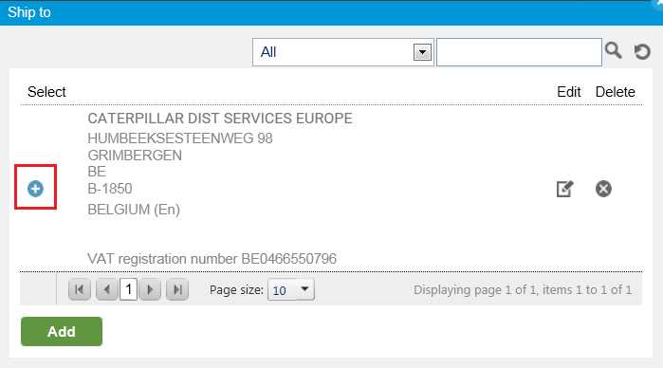
Save ‘ship to’ addresses for future invoices
Enter the required information into each box and click on the Save button. This address is now saved for future invoices.
Click on the blue icon under ‘select’ to choose from the list of saved addresses

Slide 13
Ship to addresses
This file contains the most used ship to address for Gosselies, Grimbergen and Grenoble.
Following the previous steps you should save the ship to addresses for future use.

Slide 14
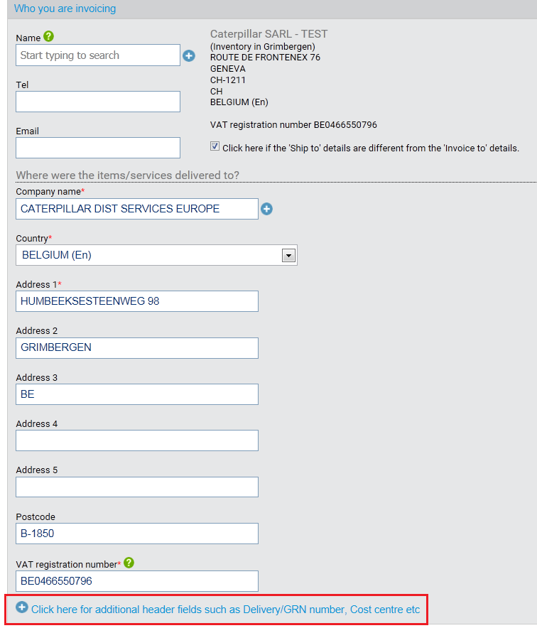
Enter a delivery note for the whole invoice
Click on the highlighted text ‘Click here for additional header fields… ‘
Enter the shipping reference (exactly the same as on the ASN) into the ‘Delivery note number’ box

Slide 15
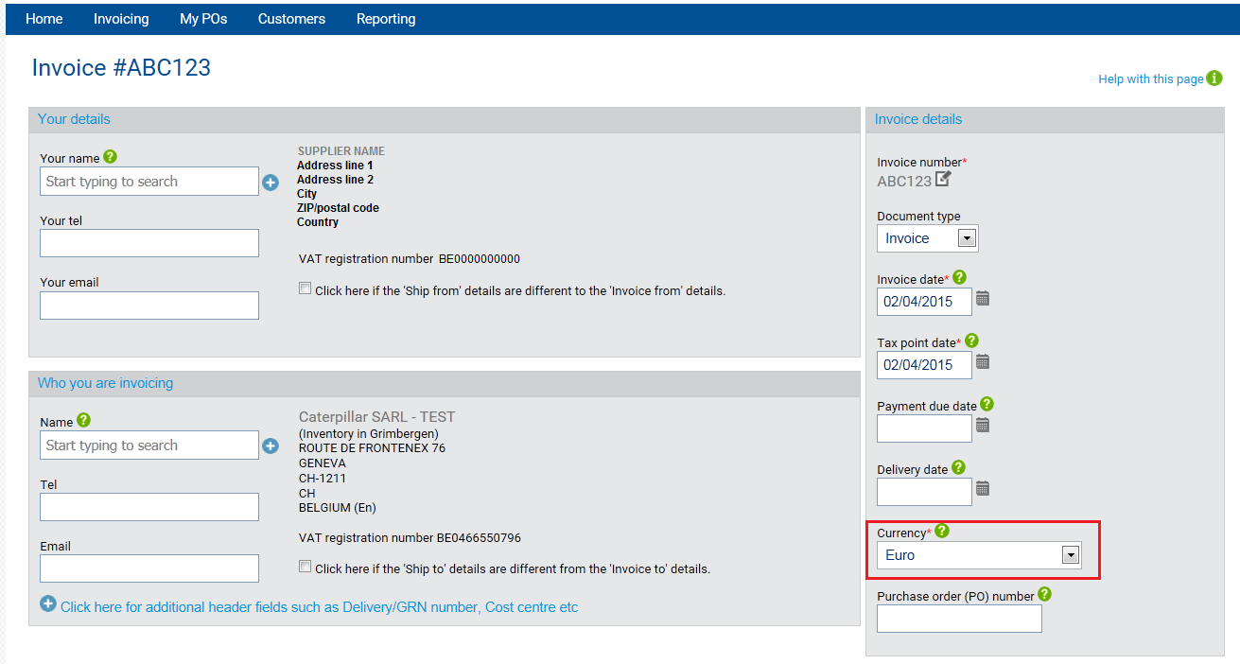
Choose your invoice currency
From the ‘Currency’ drop down box select the currency of the invoice.

Slide 16
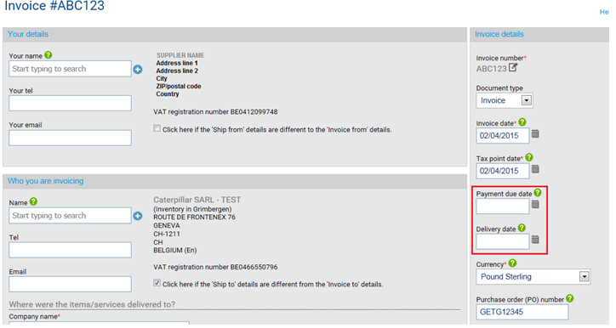
Provide a payment due date and a delivery date
Depending on your country you may be required to enter ‘Payment due date’ and ‘Delivery date’

Slide 17
Enter line items – create the first line
Create the first line of the invoice by clicking on the ‘Add’ button.

Slide 18
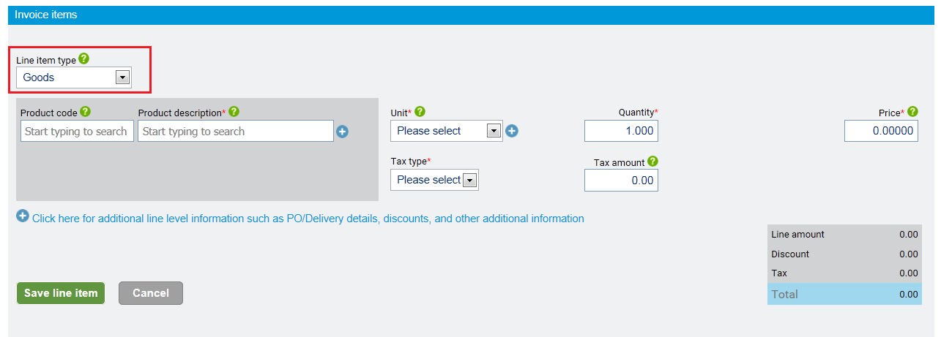
Enter line items – Choose the type of line
The default selection of the ‘Line item type’ is ‘Goods’ . Currently the first line of every invoice must be a goods line
The other option is ‘Special charge’, more on this process further ahead in this presentation

Slide 19
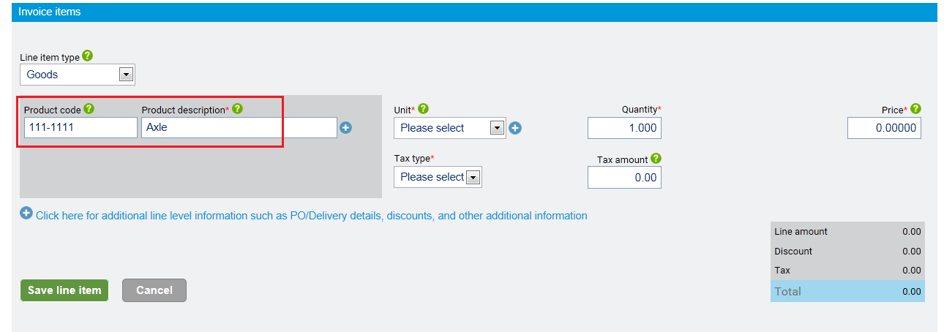
Enter line items – Caterpillar part number and description
Enter the Caterpillar part number into the ‘Product code’ box. (some orders do not contain part numbers, for these types of PO miss this box)
Enter the description into the ‘Product description’ box

Slide 20
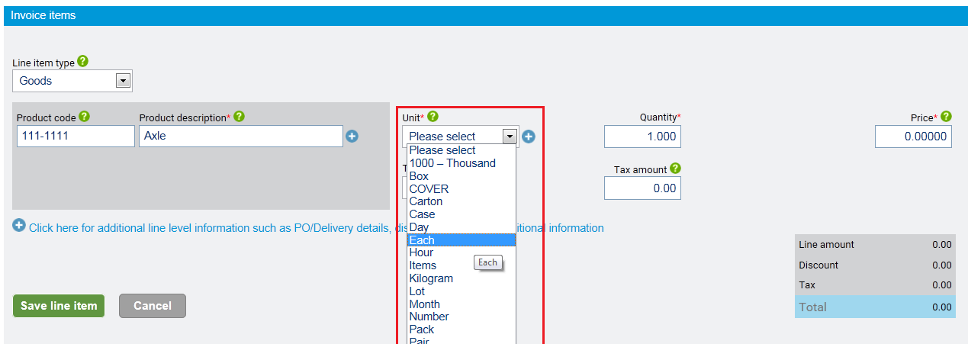
Enter line items – Unit of measurement
Select the drop down box under ‘Unit’ and choose the correct unit of measurement
The correct UOM can be found on your order received. Descriptions can vary depending on language used. Please refer to the ‘Tungsten-Caterpillar UOM’ list provided if unsure what to select

Slide 21
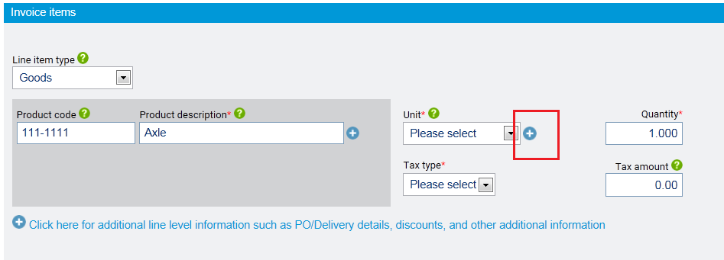
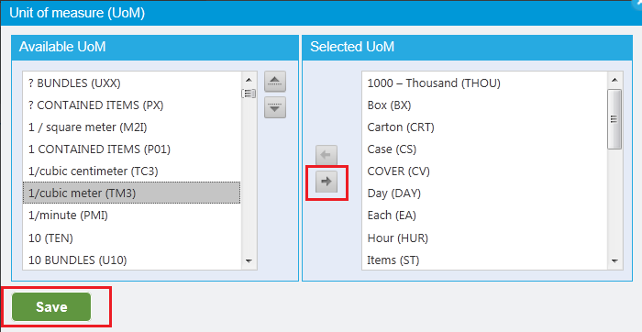
Enter line items – Unit of measurement
If the unit of measurement does not appear in the drop down box click on the blue icon to the right
Select the unit of measurement from the list. Click on the arrow to add. Save the new list.

Slide 22
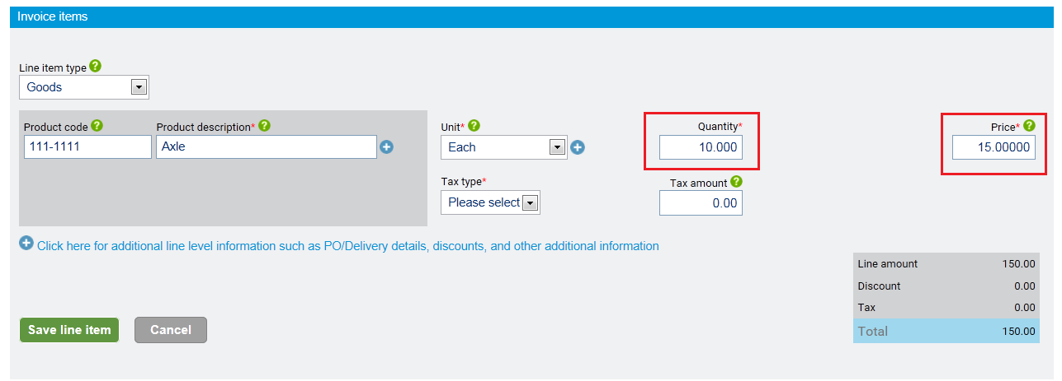
Enter line items – Quantity and Unit Price
Add the number of items in the ‘Quantity’ box
Enter the unit price in the ‘Price’ box

Slide 23
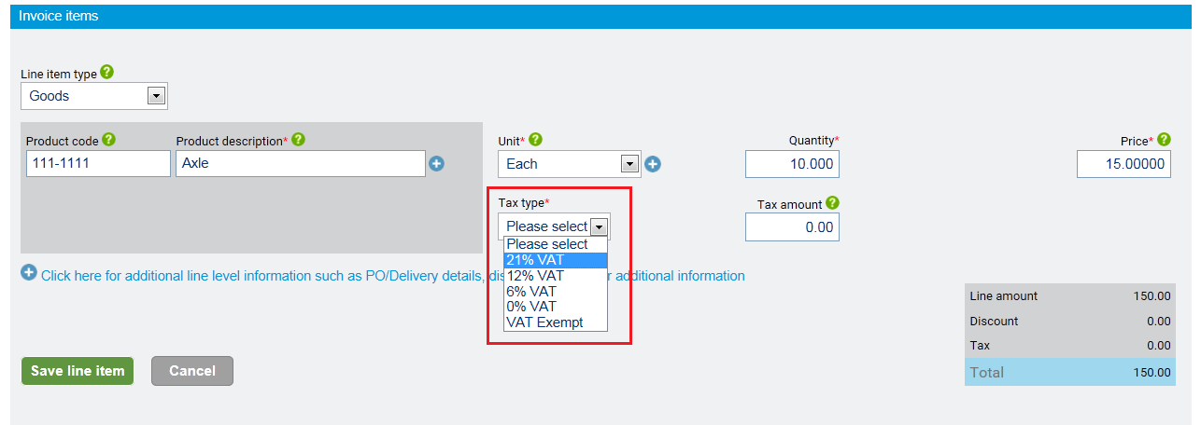
Enter line items – VAT rate
Choose from the ‘Tax type’ drop down box the correct VAT rate. These rates relate to your company’s country.
Charging foreign VAT when seller country is in a different country to place of supply and sale is currently not possible for Tungsten ‘Web form’ users. ‘Integrated’ service users may send these types of invoice.

Slide 24
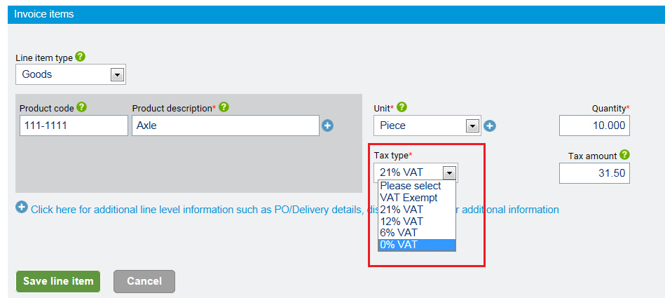
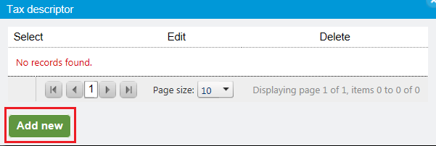
Enter line items – VAT rate of zero
First choose 0% from the ‘Tax type’ drop down box
Click on ‘Add new’ to add specify the reason no VAT will be charged on an invoice between EU states

Slide 25
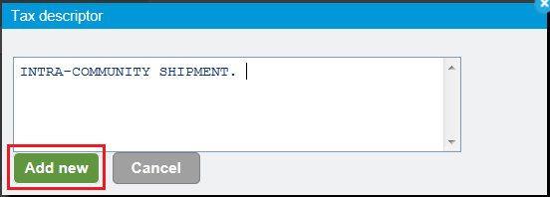
Enter line items – VAT rate of zero
In the textbox confirm the reason for not charging VAT and click on ‘Add new’
(’intra-community shipment’ or ‘Article 1…’ etc)
Click on the blue icon to select the saved reason. (will be saved to use on next invoices)

Slide 26
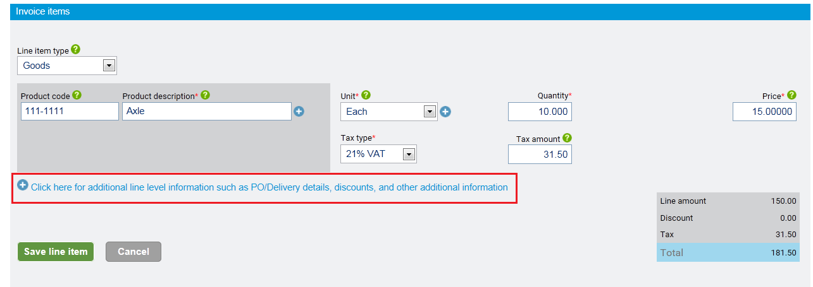
Enter line items – PO number and PO item number
Click on the highlighted text ‘Click here for additional line level information….’

Slide 27
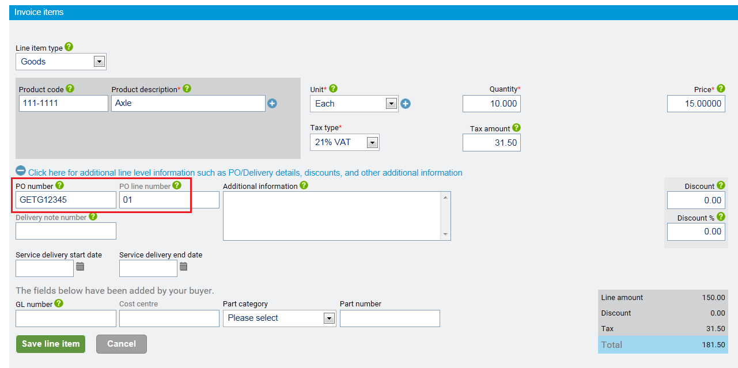
Enter line items – PO number and PO item number
Enter the Caterpillar order number in the ‘PO number’ box.
The PO number will always have a 3 or 4 letter prefix (capital letters please) and 5 numbers,
eg BAB 12345 or GETG12345 or FAFE12345
The Caterpillar order number sequence or item number must be entered into the ‘PO line number’ box

Slide 28
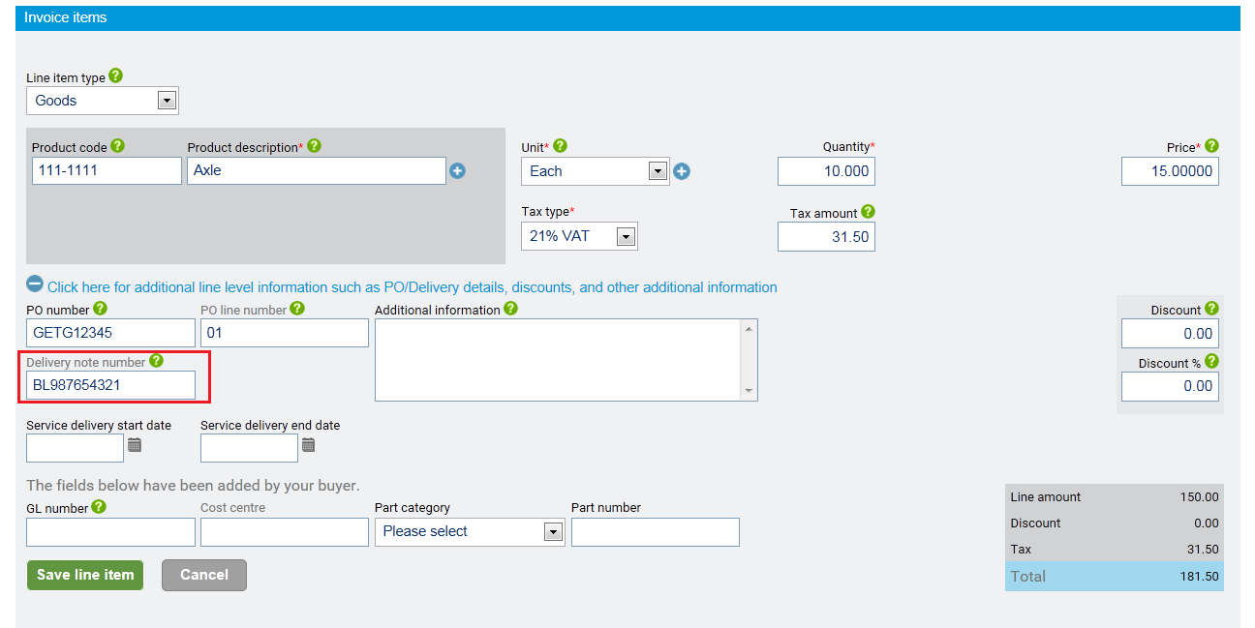
Enter line items – Delivery note number
If your invoice contains more than one delivery reference, then please enter one for each line into the ‘Delivery note number’ box.
(this should always match your ASN delivery note number to ensure automatic invoice clearing)

Slide 29
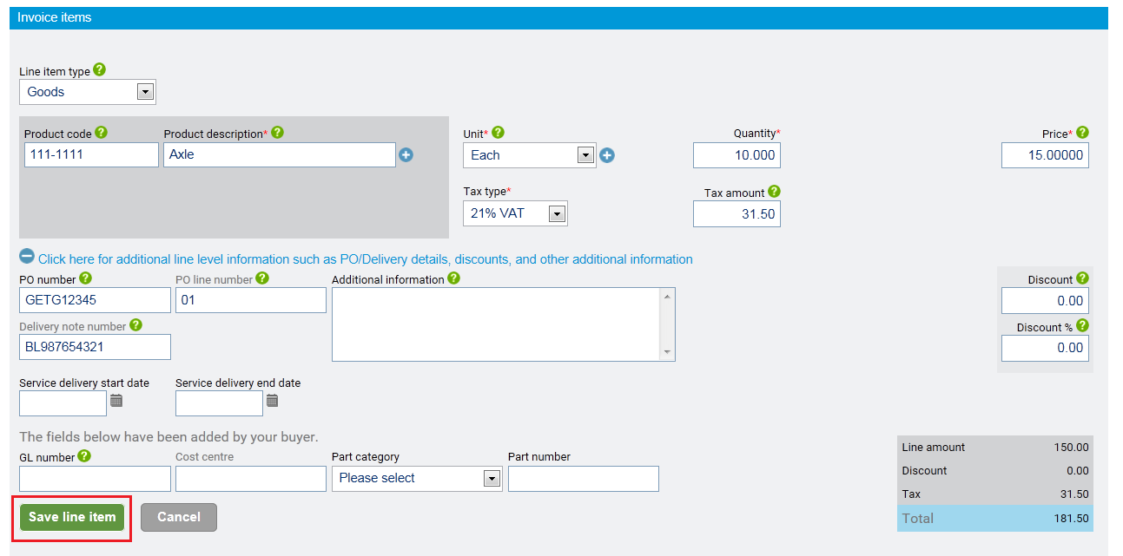
Enter line items – save the line
Click on the ‘Save line item’ icon once all details have been entered

Slide 30
Enter line items – Edit or delete the line
The saved line can still be edited or deleted with the two icons on the right of the saved line.
The ‘pen/paper’ icon is edit, the ‘x’ icon is delete

Slide 31
Enter line items – Add a new line
Click on the ‘Add’ icon to enter an additional line for the invoice.
There is no limit to the number of lines that may be entered but we recommend single line invoices to avoid delays to payment caused by one or two lines being investigated.

Slide 32
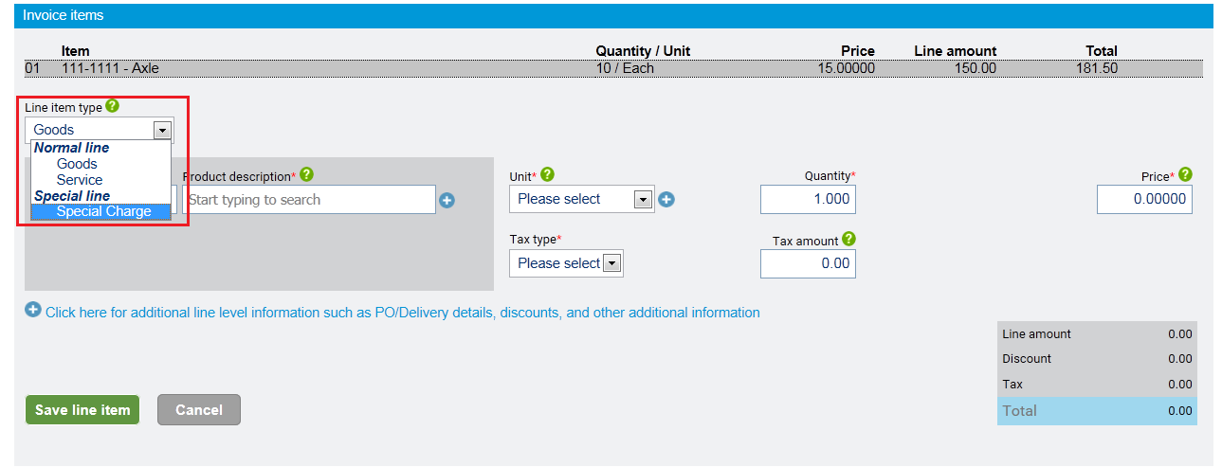
Enter line items – Special charges
Special charges may be entered on additional invoice lines. Choose from the ‘Line item type’ Special Charge. This will change the layout of the page as required for entering special charges.
It is not possible to send an invoice for a special charge only.
The special charge must always be accompanied by a goods line.

Slide 33
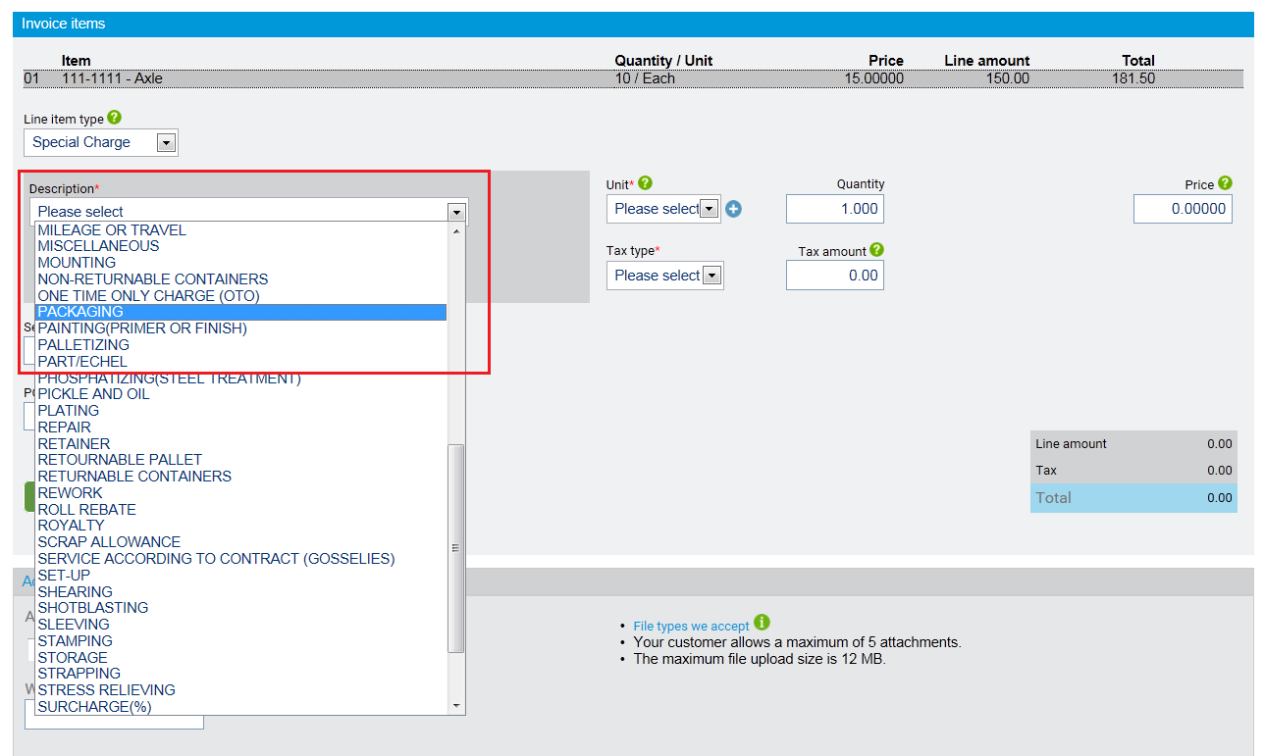
Enter line items – Special charges: description
Choose from the ‘Description’ drop down box the reason for the special charge.

Slide 34
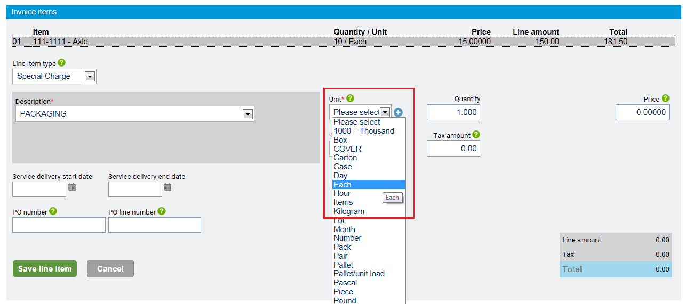
Enter line items – Special charges: unit of measure
Choose the unit of measurement for the special charge from the ‘Unit’ drop down box. If you are unsure of the correct unit of measurement check the order you received. Also refer to the Tungsten-Caterpillar UOM list provided (appended) in case descriptions differ slightly.

Slide 35
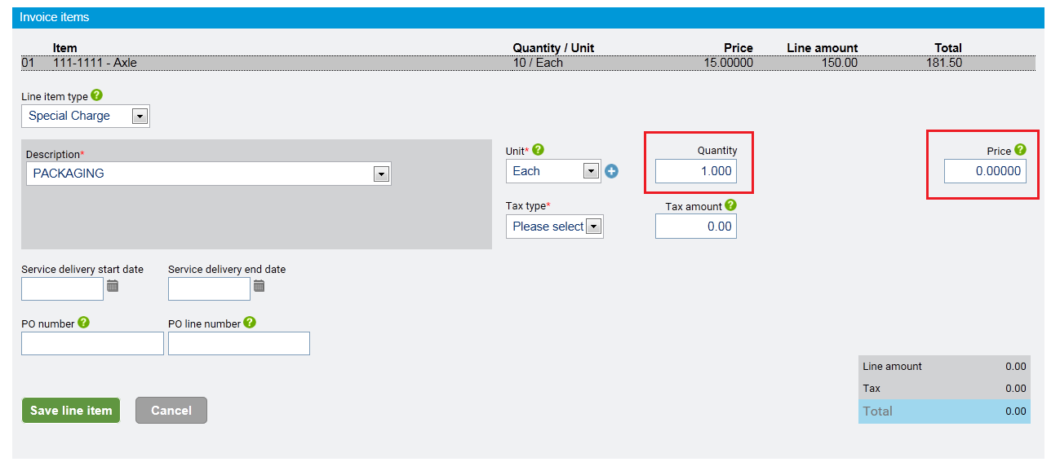
Enter line items – Special charges: qty and unit price
Enter a value in the ‘Quantity’ box
Enter the unit price of the special charge into the ‘Price’ box

Slide 36
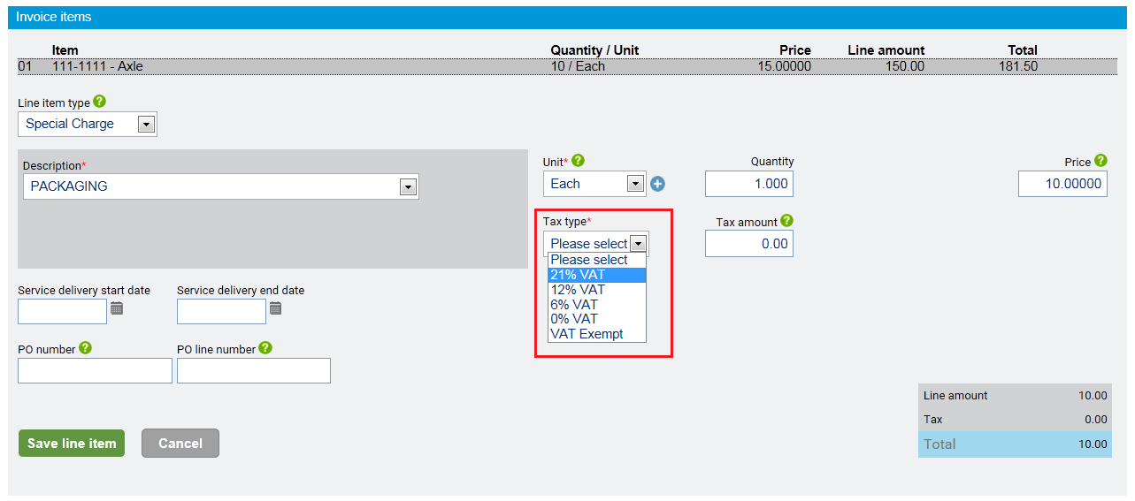
Enter line items – Special charges: VAT rate
Choose the VAT rate from the ‘Tax type’ drop down box

Slide 37
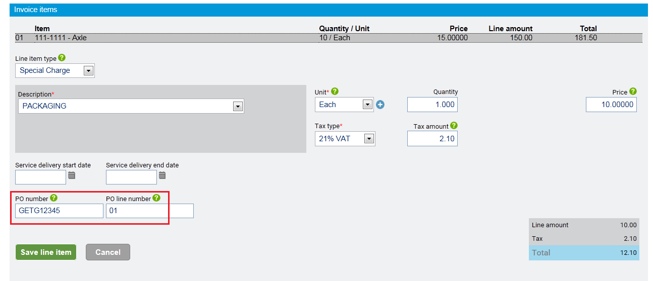
Enter line items – Special charges: PO number and PO item number
Enter the Caterpillar order number in the ‘PO number’ box.
(always 3/4 letter prefix and 5 numbers, eg BAB 12345 or GETG12345 or FAFE12345)
The Caterpillar order number sequence or item number should go in the ‘PO line number’ box

Slide 38
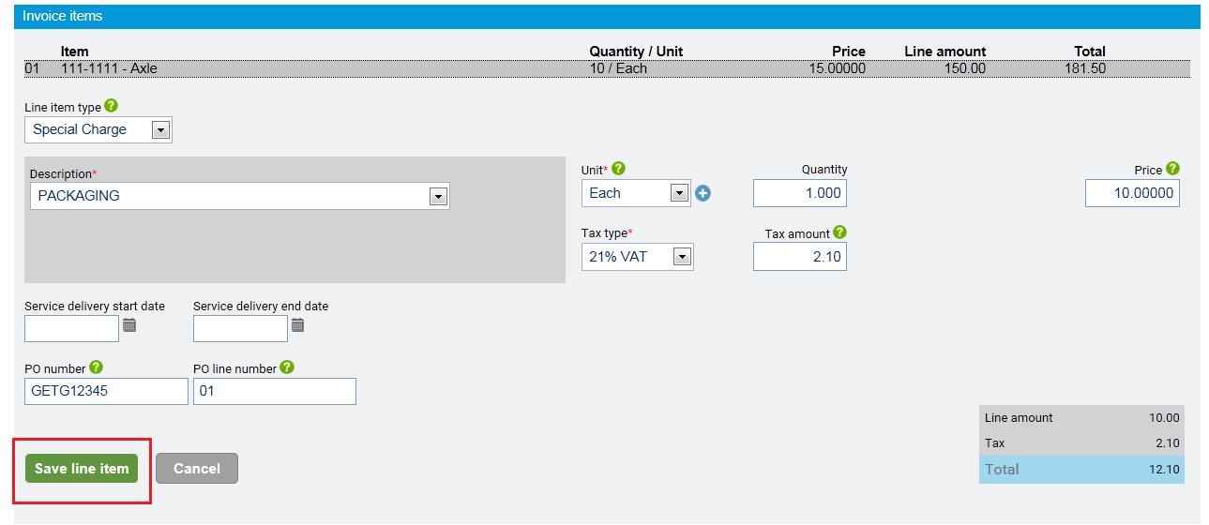
Enter line items – Special charges: save the line
Click on the ‘Save line item’ icon to complete the entry of the special charge line

Slide 39
Additional information– VAT exchange rate
When the invoice currency chosen is different to your company’s domestic currency the currency exchange rate must be entered

Slide 40
Additional information– attachments
Attachments may be added for invoices by clicking on the ‘Select and upload’ icon. These attachments will not be forwarded to Caterpillar who will have to download any attachments manually

Slide 41
Submit the invoice
Once you have reviewed the invoice and are satisfied it is correct submit the invoice by clicking on the ‘Send’ icon

Slide 42
Additional information– Save invoice as template
Invoice entered can be saved as a template and used again after changing the invoice number
Enter a name for the template and click on the ‘Save’ icon

Slide 43
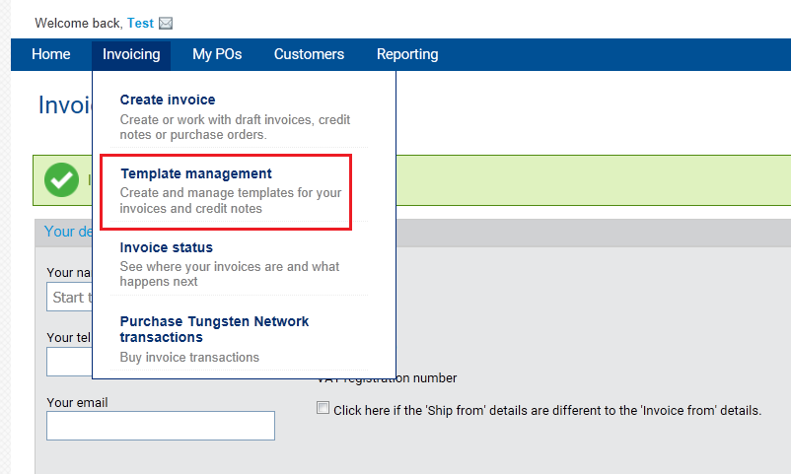
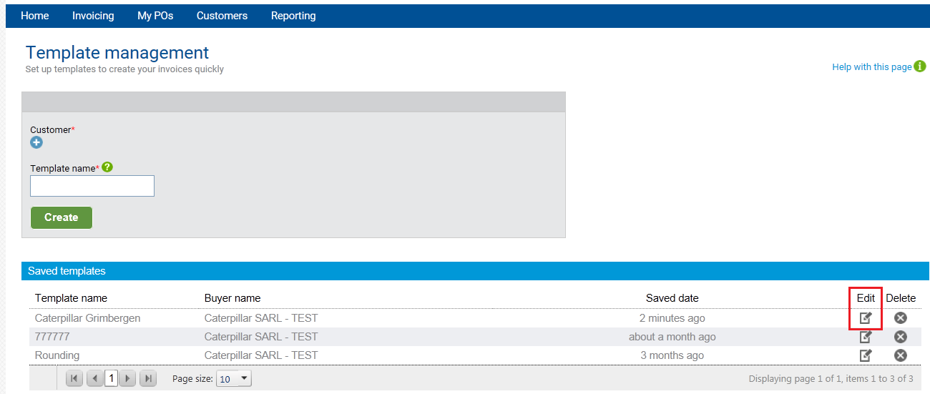
Additional information– Using a saved invoice template
From the ‘Invoicing’ menu select ‘Template management’
Choose from the list of saved templates. To use click on the ‘Edit’ icon

Slide 44
Additional information– attachments
Additional information– Using a saved invoice template
Scroll to the bottom of the invoice and click on the ‘Use template now’ icon
Provide an invoice number and click on the ‘Create an invoice’ icon

Slide 45
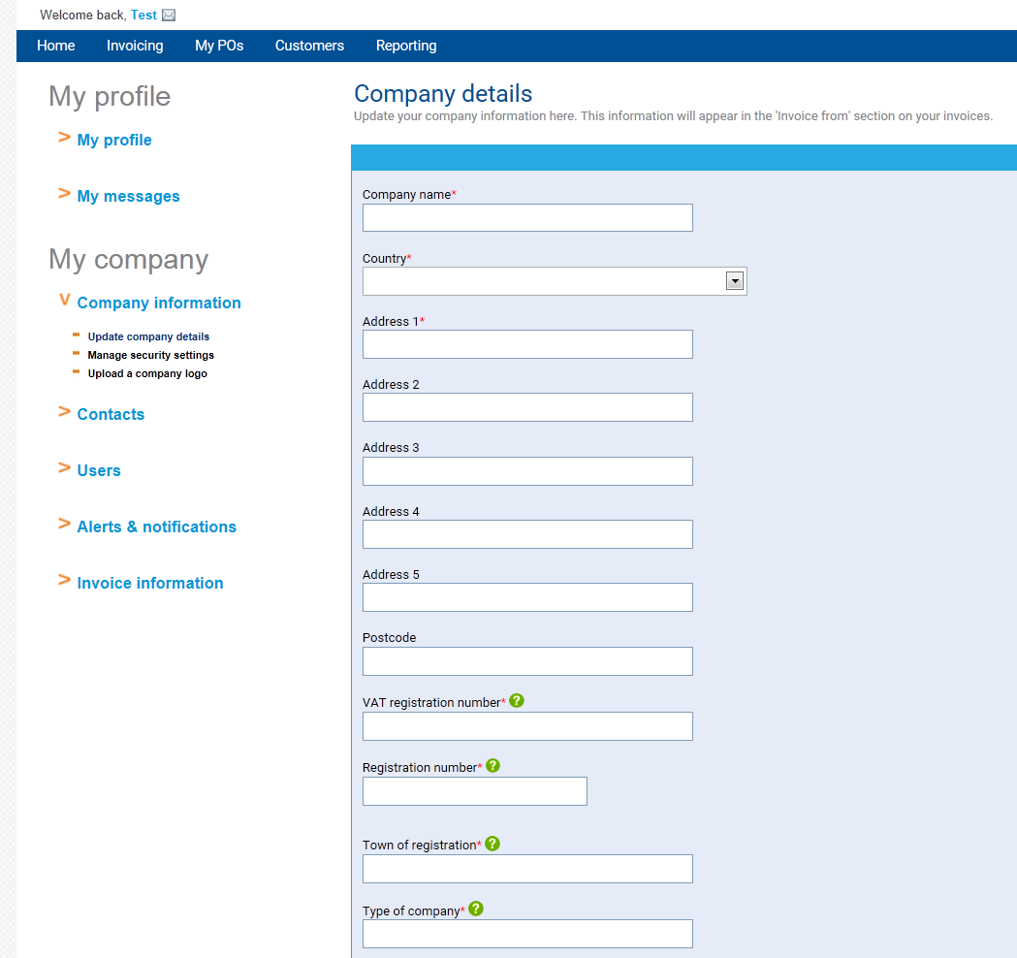
Additional information– Company details
When updating any of your company information on the Tungsten Portal please inform:
E-invoicing@cat.com
We need to make sure this information matches our ERP system. If there are differences your invoice will reject.

Slide 46
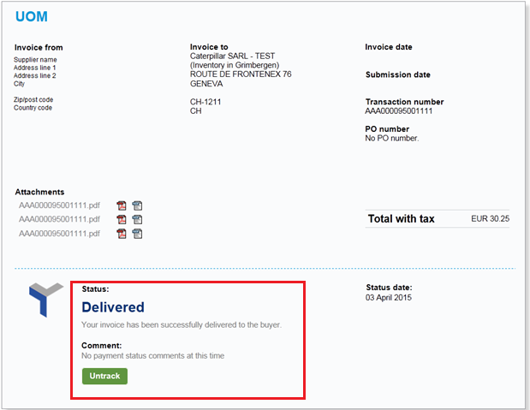
Submitted invoice status - Delivered
When the invoice has been submitted by the Tungsten Network the status will change to ‘Delivered’

Slide 47
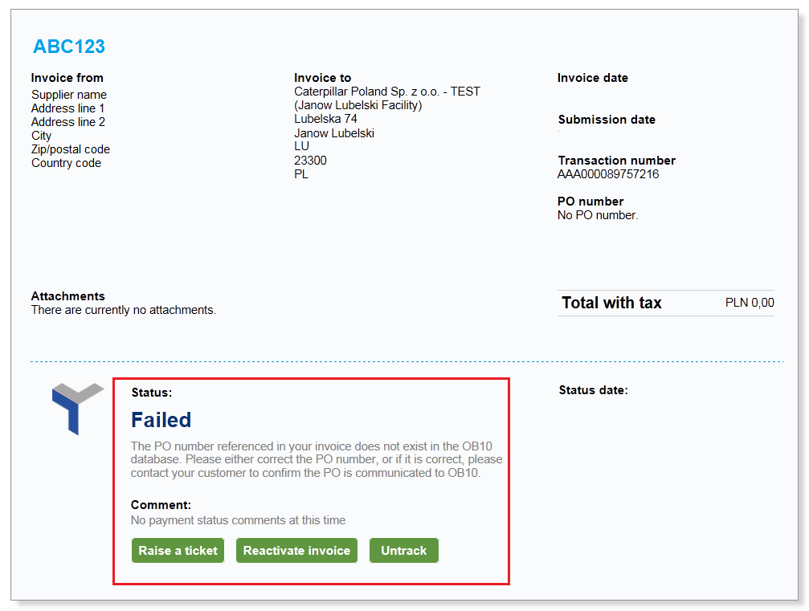
Submitted invoice status - Failed
If the invoice does not pass Tungsten’s validation checks the status will change to ‘Failed’
Failed invoices can be edited and resubmitted (or deleted) at any time. Notification of a failed invoice will be sent to you by Tungsten.

Slide 48
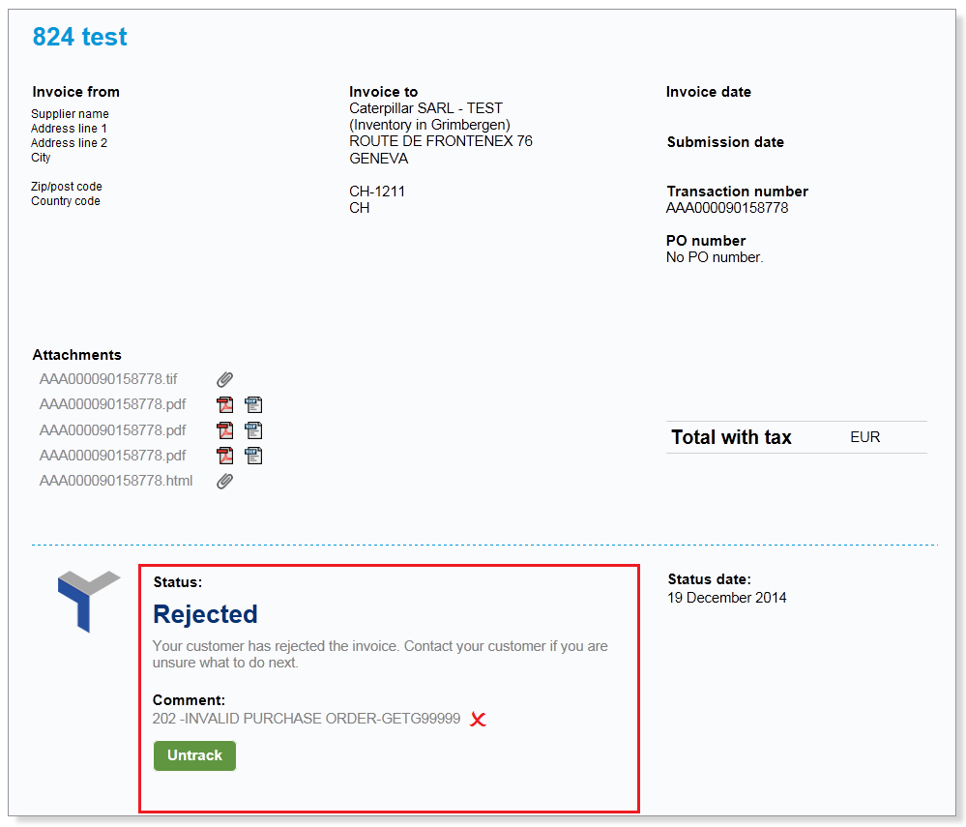
Submitted invoice status - Rejected
If an invoice sent to the Caterpillar ERP system and found to contain errors the invoice will be rejected. The rejection reason will be displayed below this status indicator.
This invoice must be resubmitted correctly using a different invoice number. (add an ‘A’ at the end, eg invoice ABC123a, instead of ABC123)

Slide 49
Additional information– reference files
This attached file contains a list of the ‘Units of measure’ codes and ‘Special charge’ (additional charges) codes

Slide 50
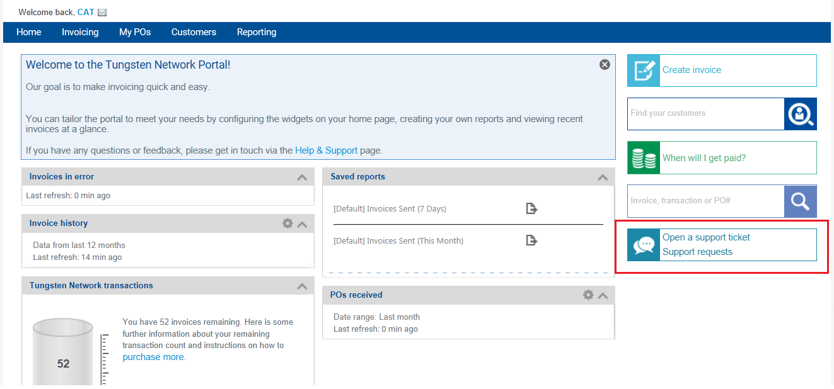
Who to contact: Tungsten
For Tungsten Portal issues a ticket can be raised with Tungsten Support Team using the highlighted link

Slide 51
Who to contact: Caterpillar
If you have a query about rejection reasons or any general enquiry regarding the process please send an email to Caterpillar E-invoicing team
Caterpillar EAME
e-Invoicing Support
e-invoicing@cat.com

